Slide 1
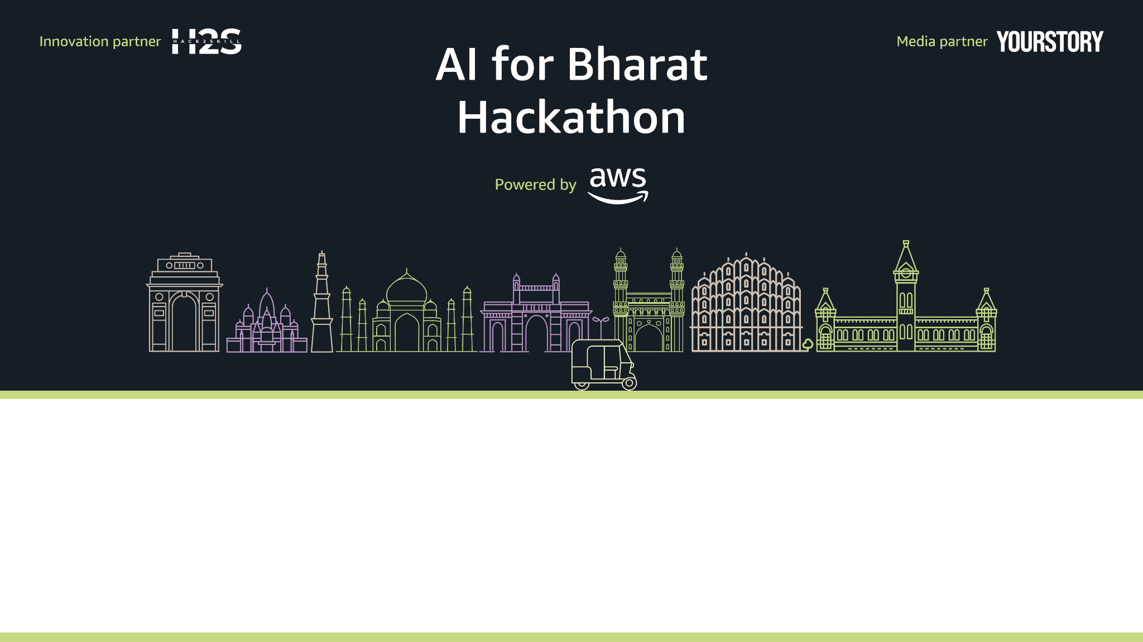
Team Name : Coin
Team Leader Name : Jagdish Kalane
Problem Statement : AI for Communities, Access & Public Impact

Slide 2












Brief About:- AI-Powered Community Assistant
COMMUNITY USER
ACCESSIBLE INTERACTION
AI-Powered Community Assistant
Natural Language Understanding
Eligibility Analysis
Recommendation Engine
Local Language Processing
Government Services & Schemes
Voice Input
Student
Education & Skill Awareness
Text Input
Real-World Impact
Farmer
Programs & Opportunities
Local Language Support
Senior Citizen
Awareness & Guidance
The system enables community members to interact in their local language and receive personalized, actionable information through an AI-powered assistant.

Slide 3
Solution For Statement:-
How Is It Different?
Not just news — life-impacting information
Designed for Bharat, not just urban users
Short, simple updates instead of long articles
Local language & voice-first experience
How Does It Solve the Problem?
AI turns complex information into quick, clear insights
Users listen or read in their own language
Important updates reach people on time
No confusion. No overload. Just what matters.
USP Why This Matters?
Information that people can actually understand
Accessible to everyone, regardless of literacy
Public-focused, not entertainment-focused
AI that serves people, not just technology

Slide 4
List of features offered by the solution
🤖 AI-Powered Summarization Converts long public information into short, clear updates
🌐 Local Language Support Content available in regional Indian languages
🎙️ Voice-Based Access Listen to updates for easy and inclusive access
📂 Smart Categories Health, Jobs, Education, Schemes, Alerts & more
📍 Location-Based Updates Relevant information based on user’s region
🔔 Important Alerts & Notifications Timely updates for critical information
👍 Simple & Clean Interface Designed for all age groups and literacy levels
🔒 Verified & Trusted Content Focus on accurate and reliable public information

Slide 5
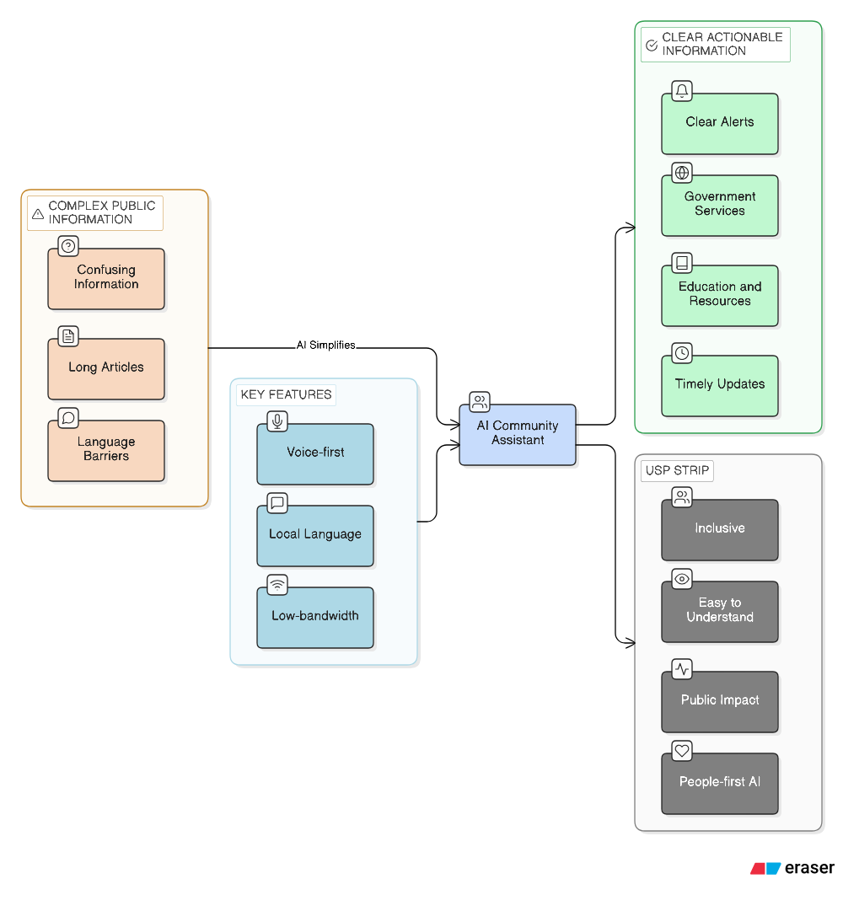
Process flow diagram:-

Slide 6
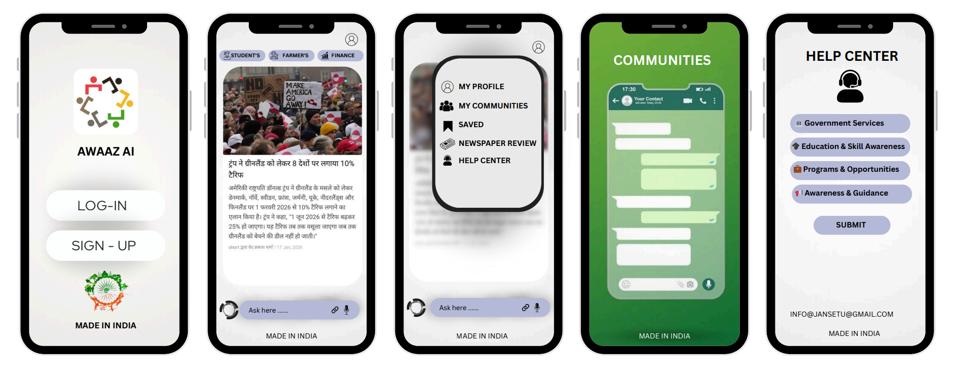
Wireframes/Mock diagrams of the proposed solution

Slide 7
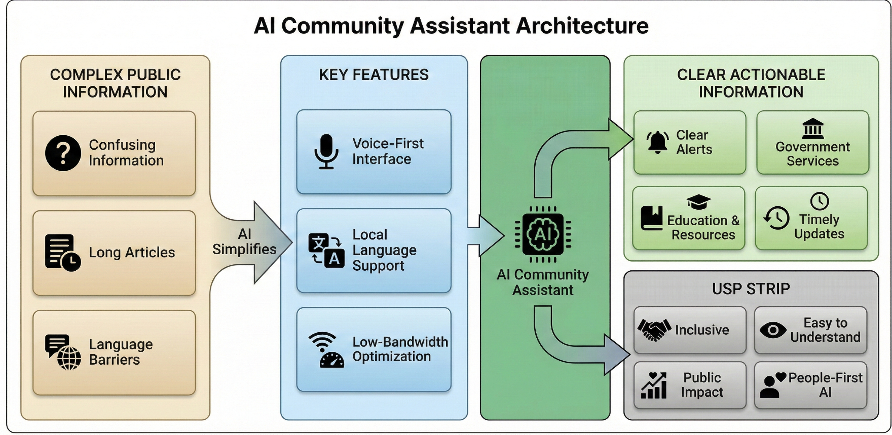
Architecture diagram of the proposed solution

Slide 8












Technologies to be used in the solution
Mobile App (Frontend)
Flutter (Android-first, single codebase)
Material UI (lightweight & accessible)
Voice-first design with minimal text and large buttons
Offline storage using SQLite
Voice & Language
Bhashini API (Indian languages – STT/TTS)
Amazon Polly (Text-to-Speech)
Amazon Transcribe (Speech-to-Text)
Supports Hindi, Marathi & regional languages
AI & Intelligence
Amazon Bedrock (LLM for summarization & Q&A)
LangChain (prompt orchestration & RAG)
Intent detection & summarization
Translation & personalization logic
Data & Knowledge
PostgreSQL (Amazon RDS) – structured data
FAISS / ChromaDB – vector search
SQLite – offline mobile storage
Amazon S3 – audio & document storage
Backend & Architecture
Python backend (FastAPI / Flask)
REST APIs with RAG architecture
Accurate, scalable AI responses
Deployment & Alerts
AWS Lambda (serverless backend)
Amazon CloudFront (CDN)
Firebase Cloud Messaging (alerts)
GitHub Actions (CI/CD)

Slide 9
Estimated implementation cost
Scope
MVP / Hackathon phase
≤ 10,000 users
Optimized using AWS Free Tier & Credits
Approx. Conversion Rate:
1 USD ≈ ₹90
Service | Monthly Cost
AWS Lambda + RDS (Free Tier) | ₹0
Amazon S3 + CloudFront | ~₹810
Amazon Bedrock | ~₹270
Amazon Transcribe | ~₹4,320
Amazon Polly | ~₹720
Amazon Translate | ~₹450
Firebase Notifications | ₹0
Total (Approx.) | ₹6,500 / month
Costs are optimized using caching, voice-on-demand, and AWS credits.

Slide 10
Impact
Scalability
🧑‍🌾 Accessible Information
Rural & semi-urban citizens clearly understand government information
☁️ Cloud-Native Architecture
Built on AWS for high availability and reliability
🌐 Language & Literacy Inclusive
Removes language and reading barriers
🌍 Pan-India Reach
Supports multiple Indian languages and regions
⏰ Timely Updates
Schemes, health alerts & job updates delivered on time
📈 Gradual Growth Model
Scales from pilot to state and national level
💡 Informed Actions
Citizens take the correct next steps
⚙️ Auto-Scaling Infrastructure
Handles millions of users with on-demand scaling

Slide 11
